Slide 1
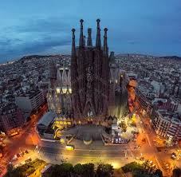
A Guide to Barcelona

Slide 2
Background
The city of Barcelona is one of the most visited cities in the world.
For a traveler to the city, it can be difficult to maximize one's time and see the great things the city has to offer.
In order to provide the best possible experience in the city, we will compare different neighborhoods within the city to determine an optimal vacation.
A traveler can use the information to determine which neighborhood to stay in based on things like food, shopping, nightlife, and attractions

Slide 3
Python Libraries
Pandas
NumPy
JSON
Geopy
Requests
Matplotlib
Sklearn
Folium
IPython

Slide 4
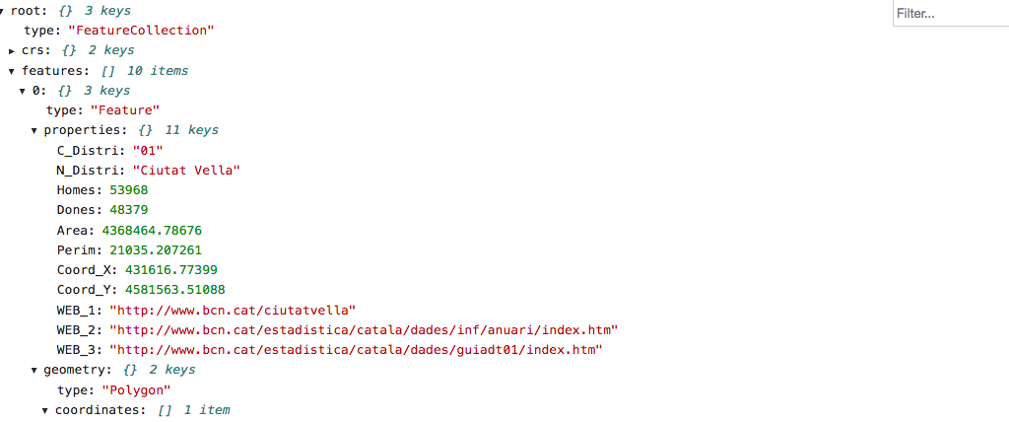
Geospatial Data
District data was obtained from a JSON file containing latitude and longitude of each district in Barcelona

Slide 5
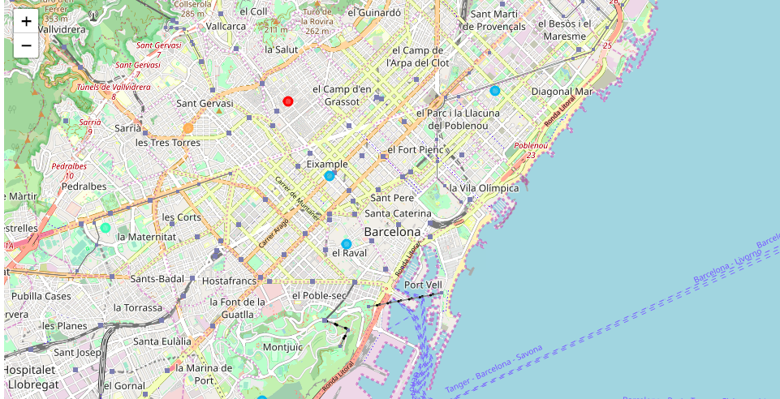
Clustering
K-means clustering was used for each district to view the top venues
Venue data was obtained from Foursquare

Slide 6
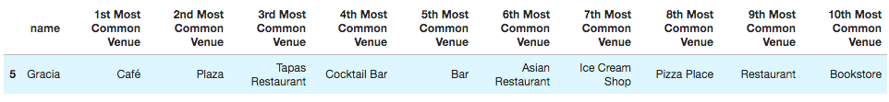
Example of Cluster

Slide 7
Conclusion
Clustering the districts of Barcelona shows how one can obtain information about food, drink, and other unique local venues
A traveler can use the information to determine where to stay, what to do, and how to make the most out the wonderful city
Questions

Slide 8

Thank You

